Slide 1

Arduino project

Slide 2



Aim :-
RFID-based attendance system is to automate and streamline the attendance tracking process, improving efficiency and accuracy in various educational and corporate settings.

Slide 3
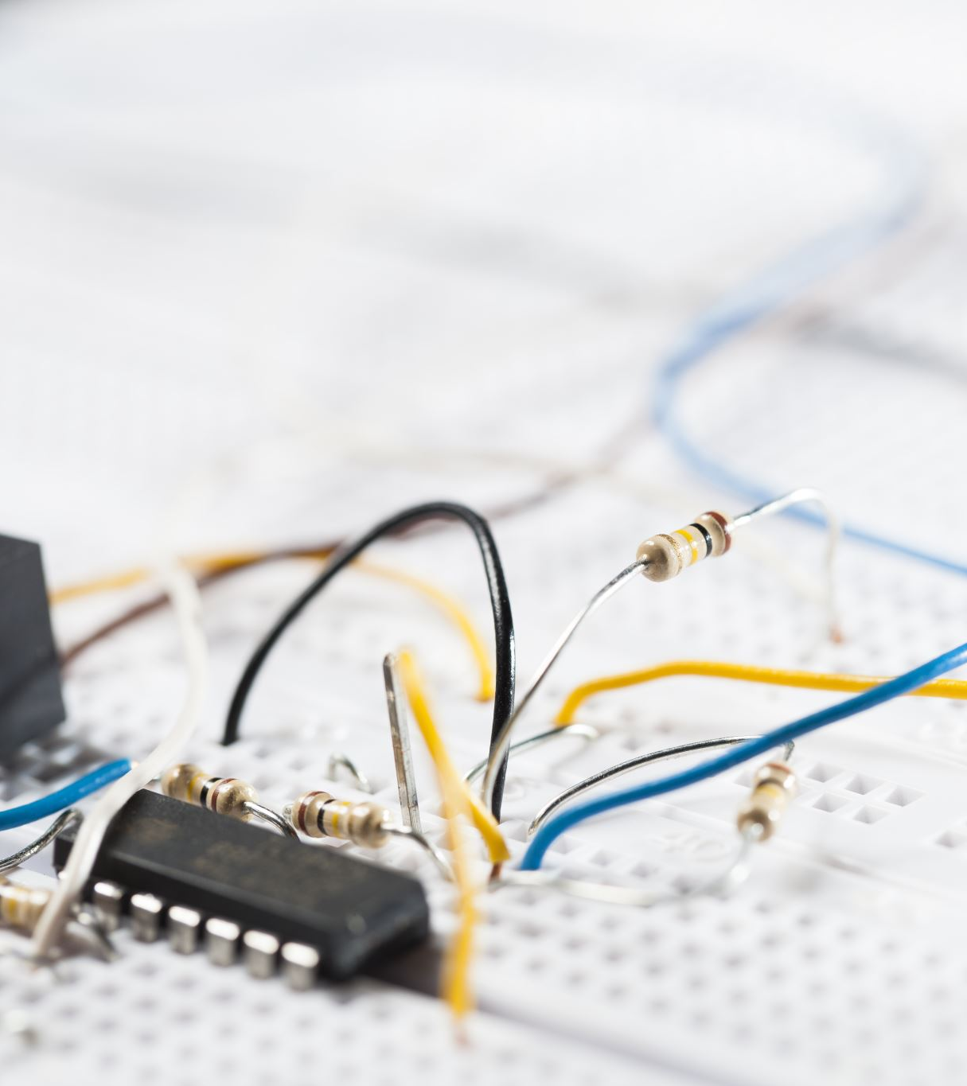
Apparatus required:-
Arduino Board – atmega328p
RFID Module
Liquid_Crystal Display
Breadboard

Slide 4
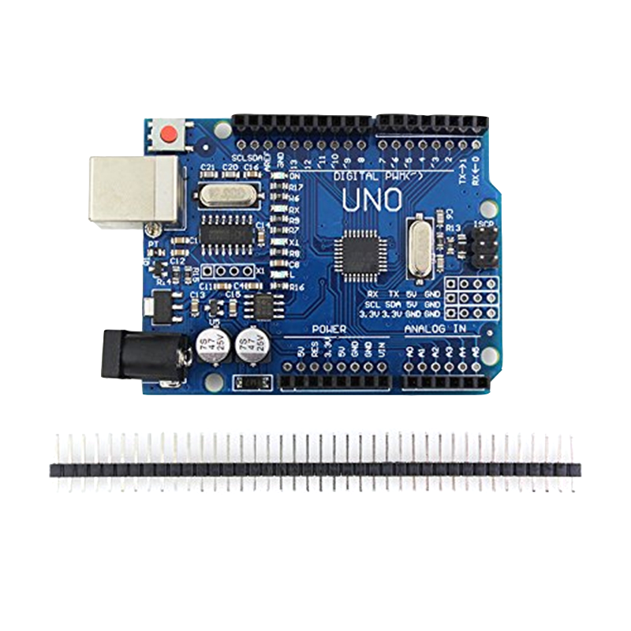
Arduino Uno:-
ATmega328 is commonly used in many projects and autonomous systems where a simple, low-powered, low-cost micro-controller is needed.

Slide 5
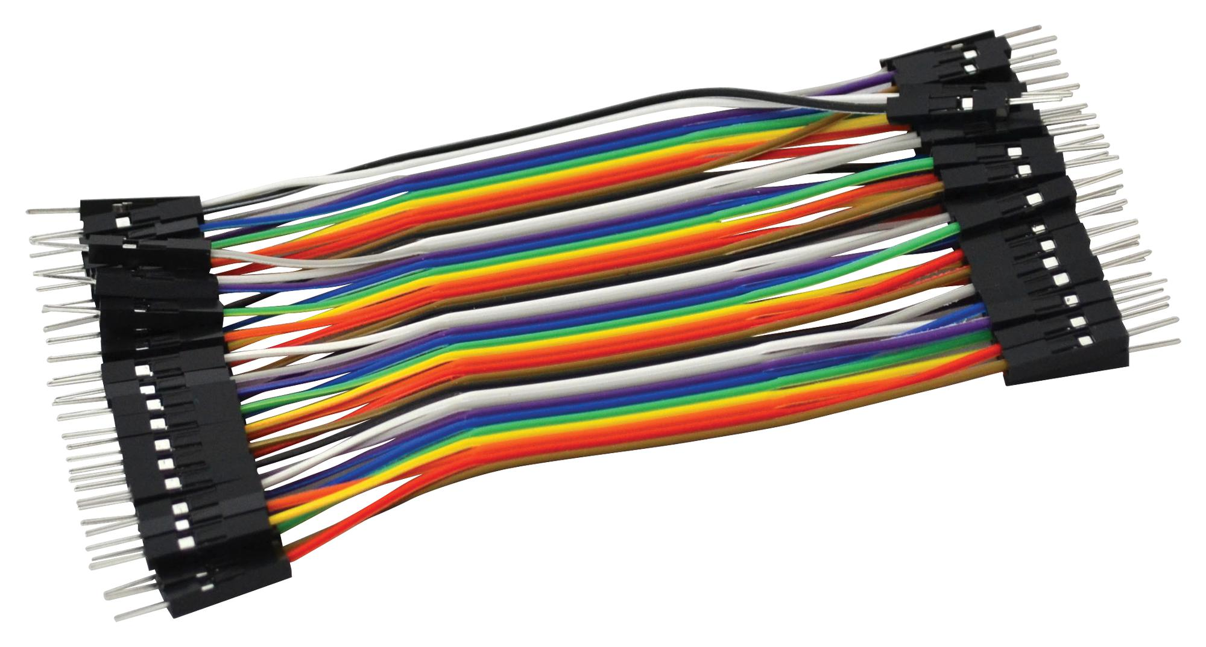

Jumper wires:-
A jumper wire is an electric wire that connects remote electric circuits used for printed circuit boards.

Slide 6
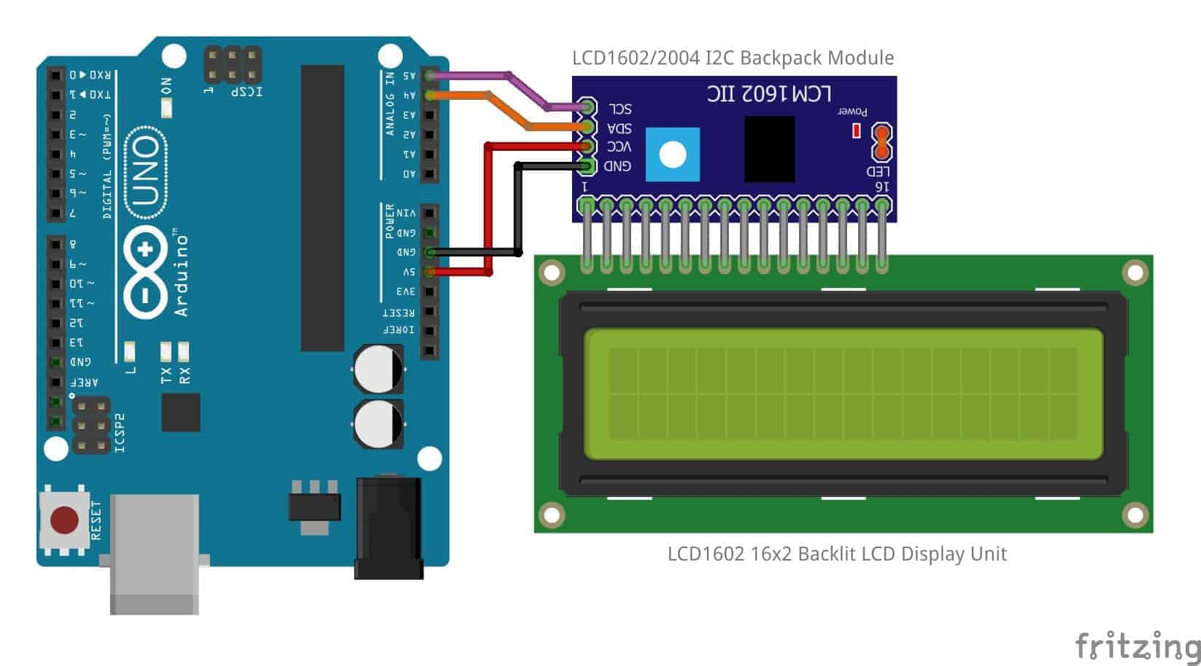
Liquid_Crystal:-
I2C_LCD is an easy-to-use display module, It can make display easier. Using it can reduce the difficulty of make, so that makers can focus on the core of the work.

Slide 7
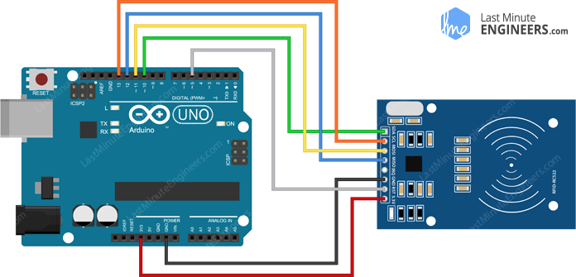
RFID Module:-
RFID (radio frequency identification) is a form of wireless communication that incorporates the use of electromagnetic or electrostatic coupling in the radio frequency portion of the electromagnetic spectrum to uniquely identify an object, animal or person.

Slide 8
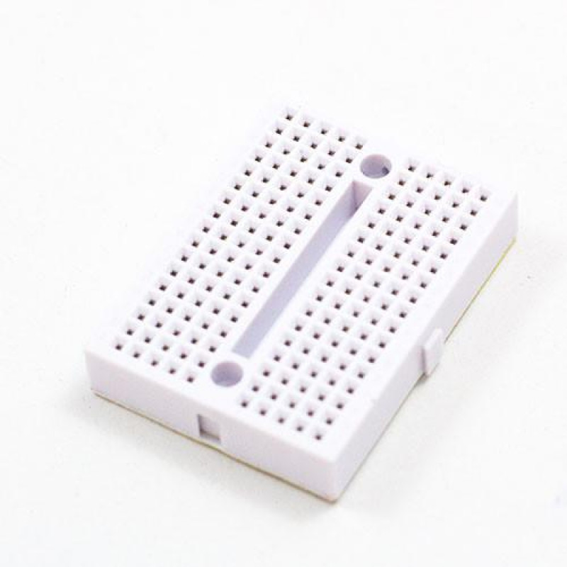
Breadboard:-
A breadboard is a rectangular plastic board with a bunch of tiny holes in it. These holes let you easily insert electronic components to prototype

Slide 9

Software Installation and Code:-
We need one software to complete this Arduino project. Arduino IDE. Download Software from the below links,
Arduino IDE 1.8.13
In this project, we are using one code: Arduino UNO

